Slide 1

WEEK 14
CESAR A. PASCAL VASQUEZ

Slide 2
For this week the main focus was to try the humanoid training from a genetic algorithm because A genetic algorithm can be cheaper than reinforcement learning when it only tunes a small set of gait parameters, such as step frequency, leg motion, and PD gains. However, using GA to train a full neural network can become expensive because it needs many simulations. For humanoid walking, GA is useful for finding a basic stable gait before improving it with reinforcement learning.

Slide 3
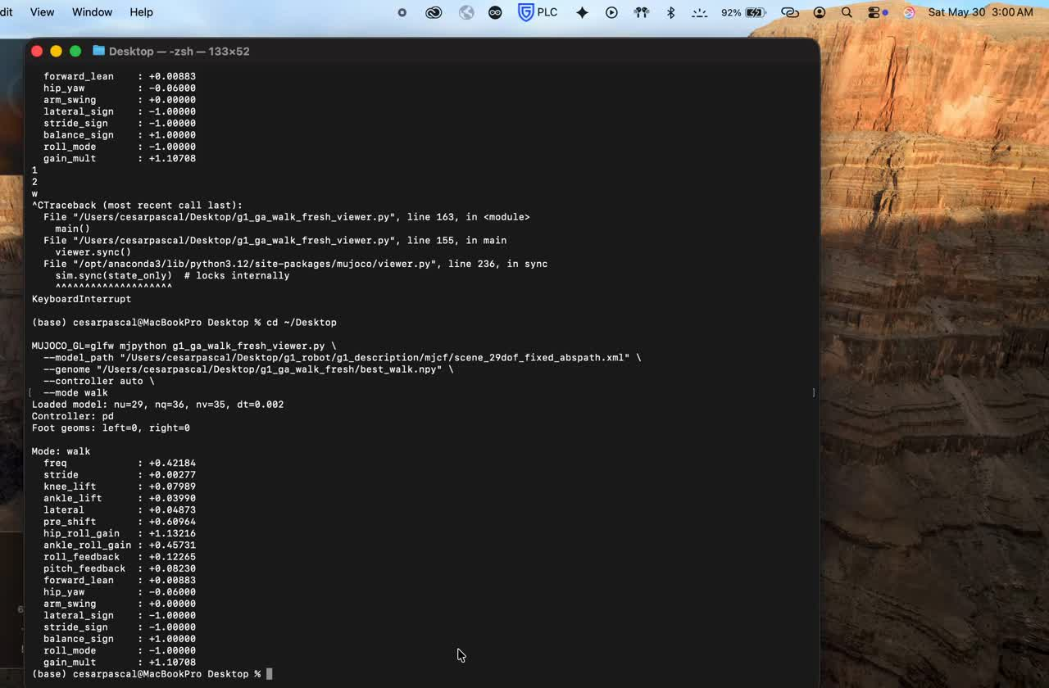
At first, the robot was able to stand, but not in a stable or proper way.

Slide 4
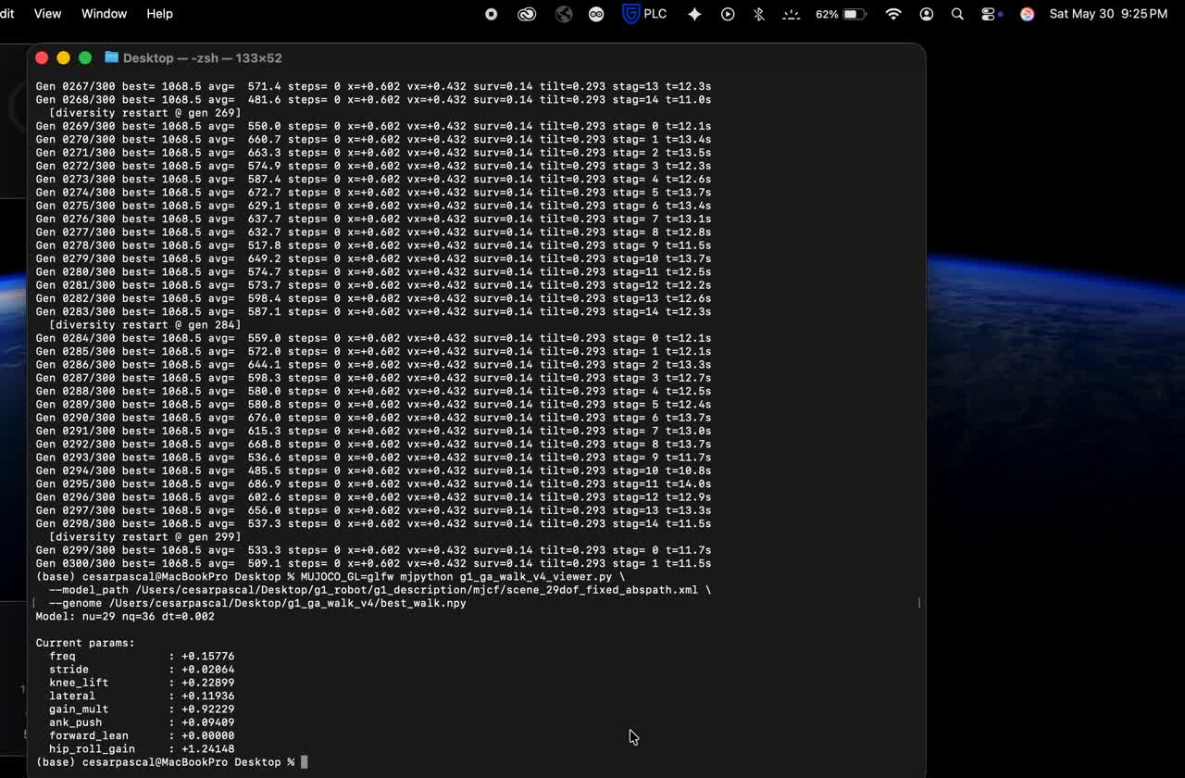
After making the training a little more robust and running it for longer, I was able to get the robot to move slightly forward.

Slide 5
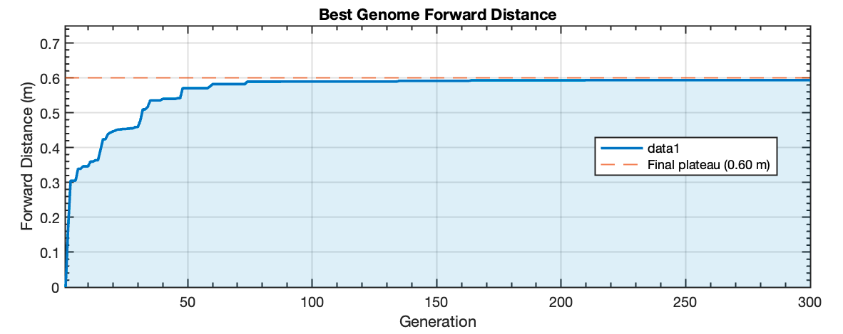
The main problem in this case was that the training became stuck after a certain number of generations, preventing further progress and limiting the robot’s ability to move better and farther, as observed here.

Slide 6
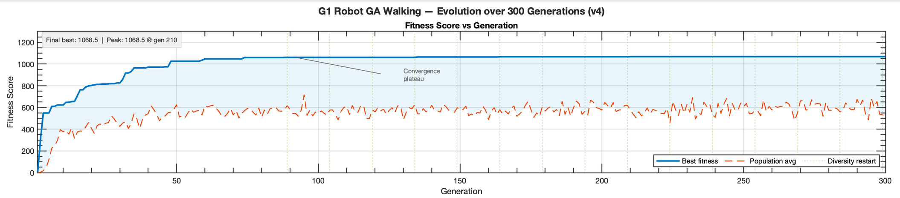
From a broader perspective, we can observe how the genetic algorithm evolved over time and understand why the final results turned out this way.

Slide 7
The main takeaway is that a genetic algorithm can be useful for the initial setup, especially for finding basic gait parameters or a starting movement pattern. However, it becomes less useful when trying to train a complete neural network by itself. For this reason, the best approach may be to use the genetic algorithm as a complement to reinforcement learning, where GA creates an initial environment or starting point that reinforcement learning can continue improving from.

Slide 8
The next step is to use the genetic algorithm only to generate a better initial walking setup, such as stable posture, gait timing, step amplitude, and joint limits. After that, reinforcement learning can be introduced to continue improving the movement, making the robot walk farther, maintain balance, and recover from small disturbances. This would make the training process more efficient because the reinforcement learning model would not start from zero, but from an initial behavior already optimized by the genetic algorithm.

Slide 9
References
  Doncieux, S., Bredeche, N., Mouret, J.-B., & Eiben, A. E. (2015). Evolutionary Robotics: What, Why, and Where to. Frontiers in Robotics and AI, 2.
  Ijspeert, A. J. (2008). Central pattern generators for locomotion control in animals and robots: A review. Neuroscience, 153(3), 642–669.
  Angeles-García, Y., Calvo, H., Sossa, H., & Anzueto-Ríos, Á. (2022). Dynamic balance of a bipedal robot using neural network training with simulated annealing. Frontiers in Neurorobotics, 16.

